Slide 1

TRIP PLANNER
https://github.com/pavaniboya/Trip-Planner-B03
Batch No: B-03 Project Guide:
B PALLAVI (164G1A0563) Mrs. S.L. Sailaja M.tech(Ph.D)
A ROHITHA (164G1A0583) Assistant Professor
B PAVANI (164G1A0564)
G KEJIYAESTARRANI (154G1A0540)
Srinivasa Ramanujan Institute of Technology
Department of Computer Science & Engineering

Slide 2
Introduction
Travel is the movement of people between distant geographical locations. Travel can be done by foot, bicycle, automobile, train, boat, bus, airplane, ship or other means, with or without luggage, can be one way or round trip.
In current scenario, Travelling is one of the few activities that most would answer as a hobby. It is something that exposes you to explore different traditions, culture, and experience.
Travelling is commonly done on various occasions. While some people travel for vacation, there are some others kind who do it for business, adventure and event.

Slide 3
Existing system
Desi Traveler is an Blog, which is used to provide the information about the travelling details and users can post the travelling details in the Blog, and also users can post the travelling information in Social media like Facebook, twitter and Google plus etc..,
The main them of this application will provide only UI (User Interface ) about traveling information of this application.

Slide 4
Proposed System
The proposed system is used to improve the application as good and smart product. This proposed system overcomes the entire drawbacks of the existing system.
Firstly, user must sign in to the application then he can able to see the provided database or the previously posted travel information by some other people over there.
User can plan trip of his interest through this application along with people in and out over application. They can share their experiences by posting pictures in their profiles with the description needed and can suggest the best places they visited and communication is done among them through inbox provided in our application.

Slide 5
Abstract
Travelling is a great experience. People travel across the world to gain knowledge and experience of different situations.
The existing system is that the travel agencies plan the trips and they will take a group of people to the specific tourist places as per the preplanned schedule like desi traveler as a webpage.
The proposed system enables the registered travelers to find the other travelers of same interest.
In this the trip planner feature allows the travelers to plan the trip with the time, locations and form a group to interact among themselves, Interested ones can collaborate and make their trip successful.

Slide 6
Technologies Used
Software Requirements:
Operating System: Windows 10
Database: Firebase
Programming Languages: Core Java
Tools: Android Studio 3.5.3
Hardware Requirements:
Ram size: 4 GB
Smartphone
i3 Processor

Slide 7
Problem Statement
People can collect the information about the tourist places according to their plans what they are going to visit but it is difficult to know the real time experiences. A tourist needs modern technologies which can serves to them, so this android application should be easy to use and efficient to manage the travelling activities. This android application enables the registered traveler to find the other travelers of same interest. The trip people plan the trip and posts pictures. Interested travelers can collaborate and complete the trip.

Slide 8
User Module
The user has to create the account or sign in the account. If we have already created the account you can just sign in.
User can post pictures regarding their travelling experiences and they can make others to travel by posting pictures with the description and this gives a real time experience to the people and they can like, comment and share for the posted pictures and they can also edit their profiles.

Slide 9
Server Module
The user has to create an account or sign in the account. Server gives the response to the user with their login information by providing authentication to the user and the data base given by user can be stored in server.

Slide 10
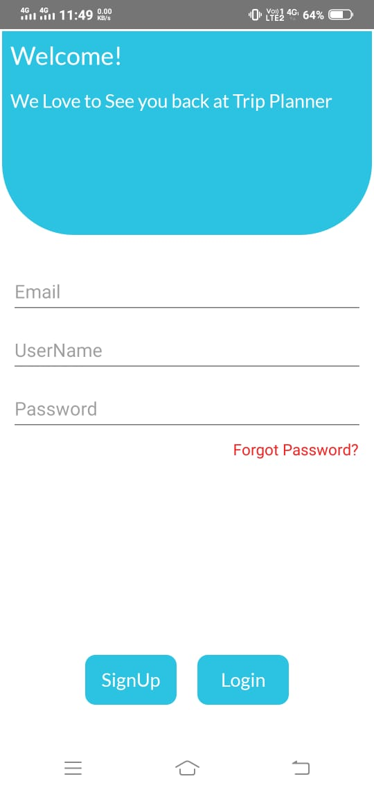
Welcome Page
Welcome Page for Travel Planner application.

Slide 11
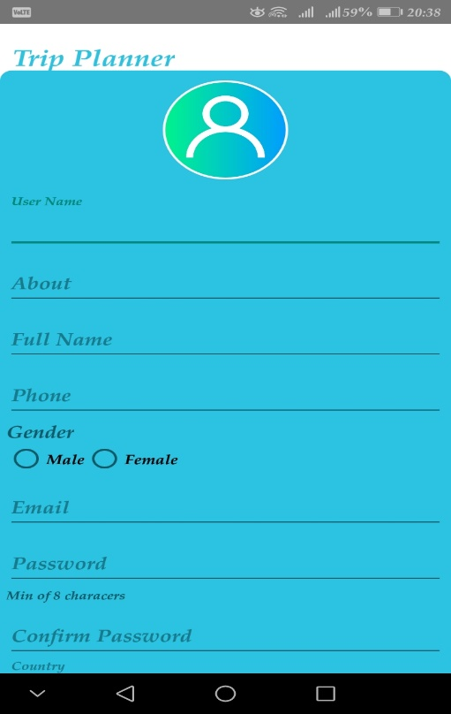
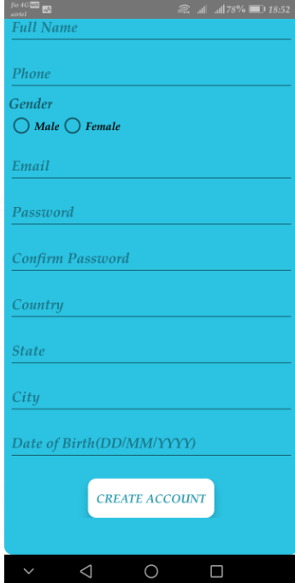
Signup page
Signup page for registration.

Slide 12
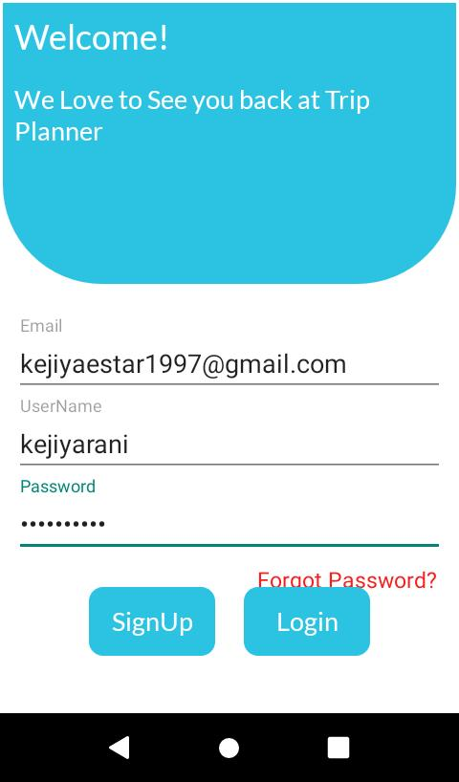
Login Page
Login screen where user can login in to the app

Slide 13
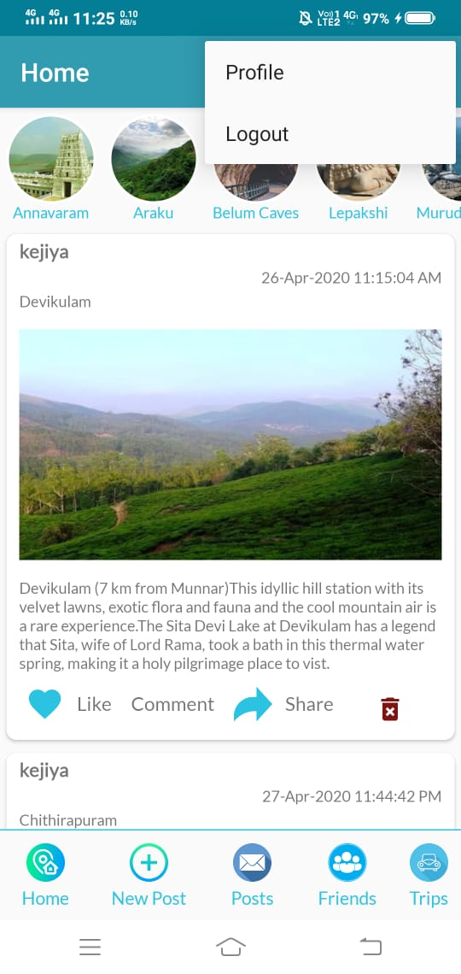
Home page
Home page of app showing posts.

Slide 14
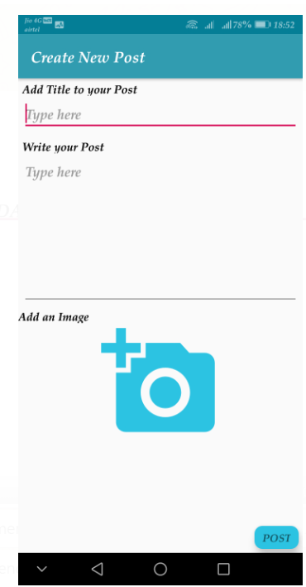
New post page
New post page, Here we can post the pictures.

Slide 15
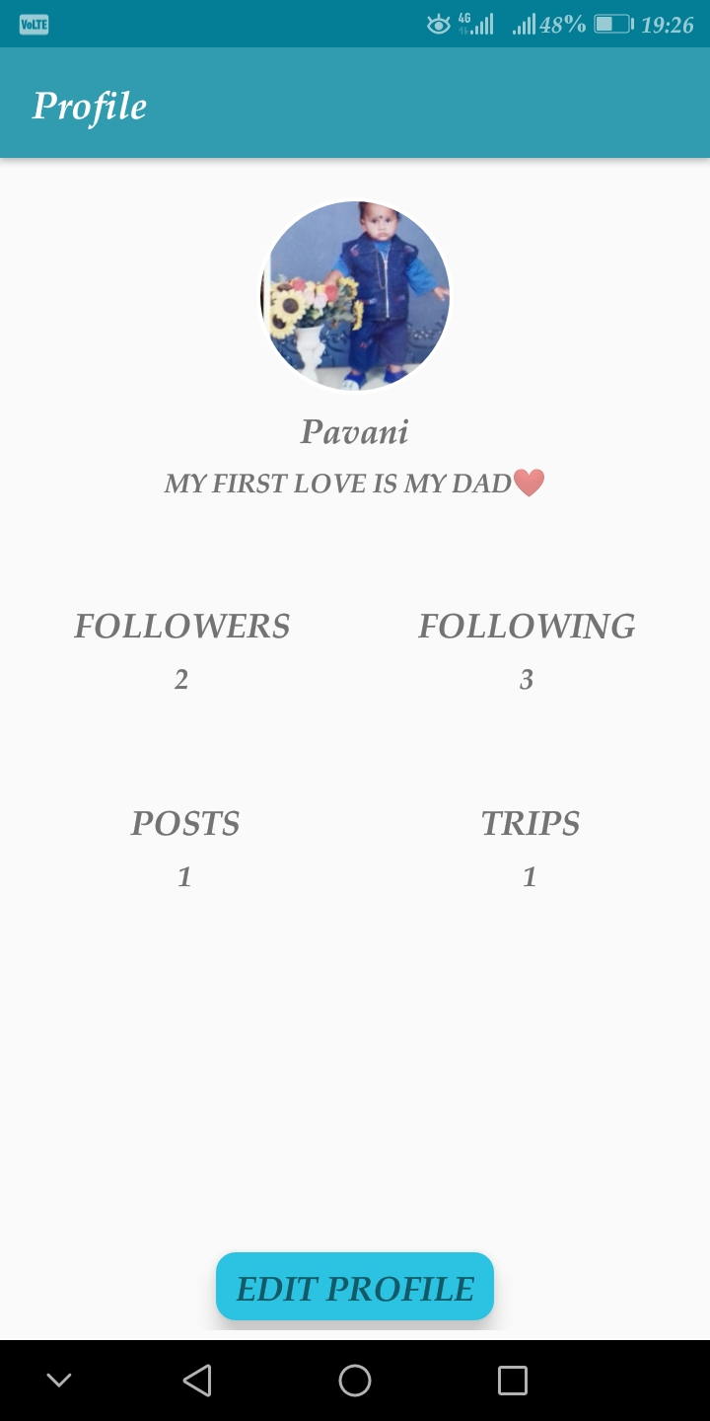
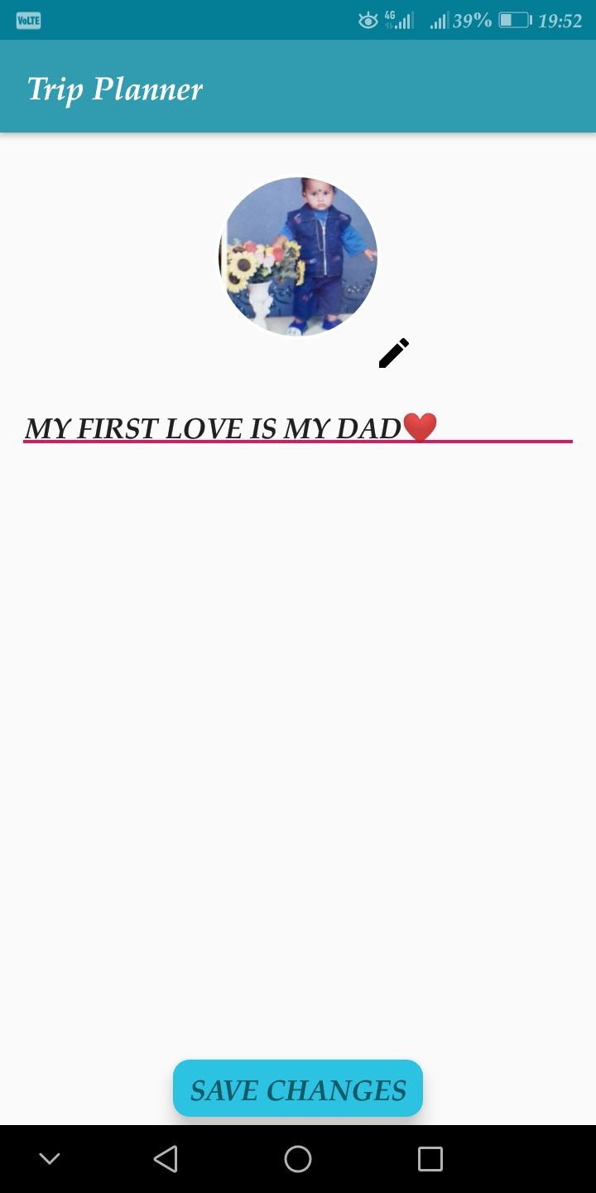
Profile page of user and edit options
Profile page of user and edit options that a user can change his profile picture and bio and count about followers, following, posts, trip.

Slide 16
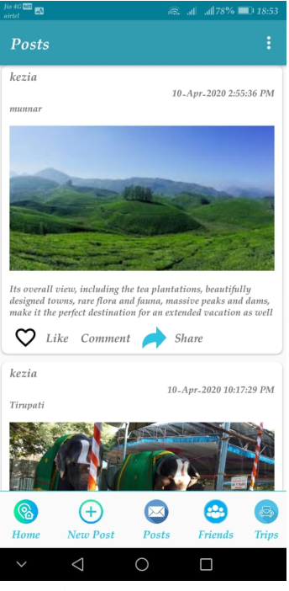
Post page
This is a post page where all other posted pictures can also seen.

Slide 17
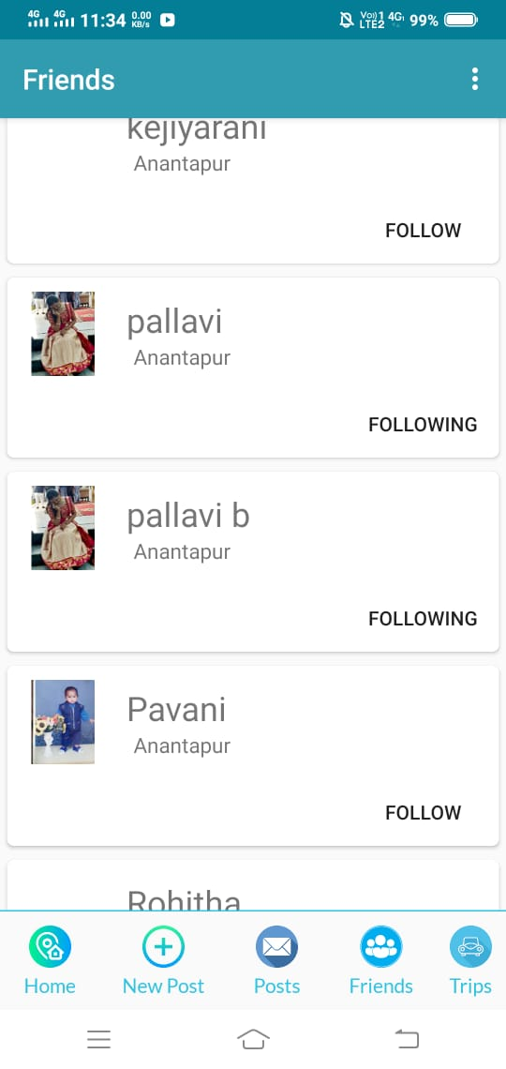
Friends page
Friends page where user can follow others.

Slide 18
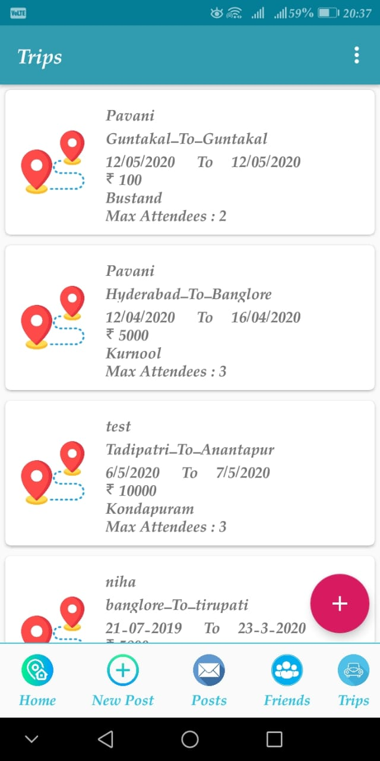
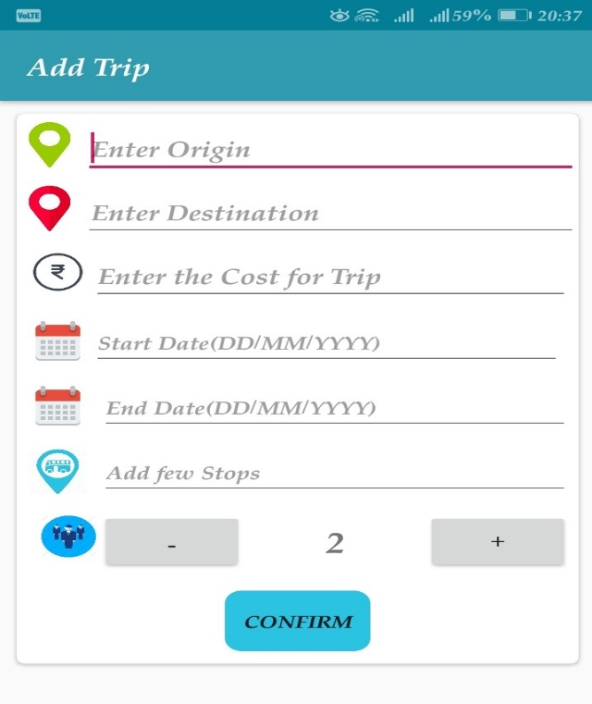
Trip Page
Trip page, in this page it will show the planed trips by the users and others. If the user follow the trip he chat with the trip planner about the trip.
Add Trip, here the user can add a trip.

Slide 19
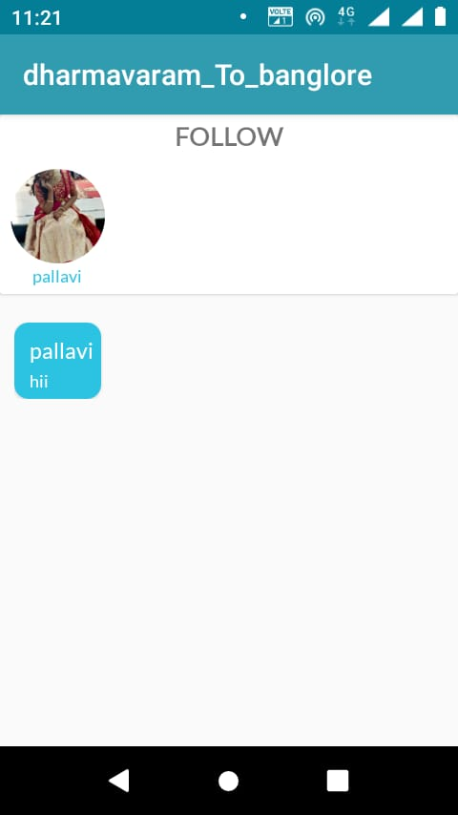
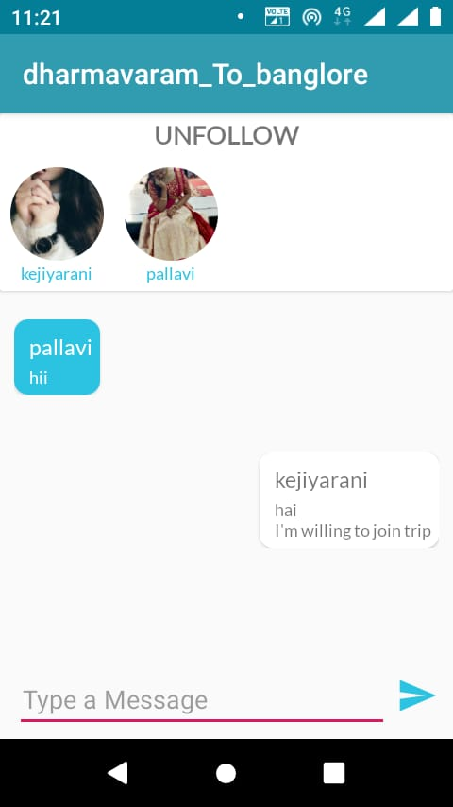
Follow and Unfollow Page
If user does not follow the trip he can’t chat with the trip planner.
If the user follows a trip he can chat with the trip planner about the trip.

Slide 20
Conclusion
Travel Planner is helpful for users to Travel and easy to communicate with others and collaborate to go the Trip through this application. This application is portable and can be easily installed and used on any mobile phones supporting Android OS. The use of this system is get information about the place they need to travel and post their pictures as a memory and get complements and likes from others through this application. It consists of some data about the tourist place who are visited the places and also provides an interface which is easy to understand by the users and greatly helps in adapting to the use of this system.

Slide 21
Bibliography
Bibliography 1:
Title: Tourism Guide for Tamilnadu (Android Application)
Authors: P. K. Jithin , P. Prasath, M. Vishnuram, J. T. Thirukrishna
Published on: April 2018
In this paper Author presents find the details of the tourist place which the user wants to visit.
It can realize to query information for various places and gives multi output and hence it has more practical significance.

Slide 22
Conti..
Bibliography 2:
Title: Tourist experience expectations: questionnaire development and text narrative analysis
Authors: Chieh-Wen Sheng and Ming-Chia Chen
Published on: 22 February 2015
In this paper Author presents including various experiences of speciﬁc events or daily life during the trip.
Tourist experience expectations are the output between tourists and tourism systems before the trip.

Slide 23
Conti..
Bibliography 3:
Title: A Web-Based Diary and Companion Smartphone app for Travel/Activity Surveys
Authors: Stopher and Greaves
Published on: 2007
In this paper Author presents improve the quality of data collected, encourage participation and reduce participant burden, while keeping costs down ,an updated diary and smartphone app were developed.
Data quality was measured using the number of (valid) trips entered by participants and the number of trips the user travelled.

Slide 24
Thank you
Queries
?

